Slide 1
Image Compression
Digital Image Processing
Notes:
‹#›

Slide 2
Image and Video
Notes:
‹#›

Slide 3
Formats
RGB is not used for transmission of signals between capture and display devices
Too expensive, needs too much bandwidth
Converted to luminance and chrominance formats
Use standard YIQ or YUV format
Notes:
‹#›

Slide 4
Compression Issues
How many bits we need?
Deals with perceptible color resolution
Has to do with difference threshold
How much frequency do we need?
Deals with perceptible frequency
Both spatial and temporal
How much can we perceive?
Notes:
‹#›

Slide 5
Compression Issues
Bandwidth requirements of resulting stream
Bits per pixel (bpp)
Image quality
Compression/decompression speed
Latency
Cost
Symmetry
Robustness
Tolerance of errors and loss
Application requirements
Live video
Stored video

Slide 6
Compression Basics
Simple compression
Statistical techniques
Interpolation-based techniques
Transforms

Slide 7
Compression Basics
Simple compression
Statistical techniques
Interpolation-based techniques
Transforms
Notes:
‹#›

Slide 8
Bit Reduction
Notes:
‹#›

Slide 9
Compression Basics
Simple compression
Statistical techniques
Interpolation-based techniques
Transforms
Notes:
‹#›

Slide 10
Color Look-Up-Table (Statistical)
Notes:
‹#›

Slide 11
Run Length Encoding
Notes:
‹#›

Slide 12
Notes:
‹#›

Slide 13
Notes:
‹#›

Slide 14
Compression Basics
Simple compression
Statistical techniques
Interpolation-based techniques
Transforms
Notes:
‹#›

Slide 15
Interpolative Compression
Acquire chrominance at lower resolution
Humans have lower chrominance acquity
Sub-sample by a factor of four in horizontal and vertical direction
Notes:
‹#›

Slide 16
Interpolative Compression
Acquire chrominance at lower resolution
Humans have lower chrominance acquity
Sub-sample by a factor of four in horizontal and vertical direction
Notes:
‹#›

Slide 17
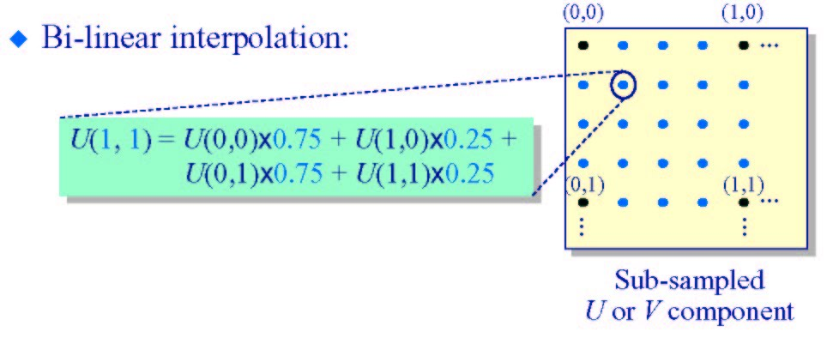
Reconstruction
Using bilinear interpolation
Gives excellent results
Notes:
‹#›

Slide 18
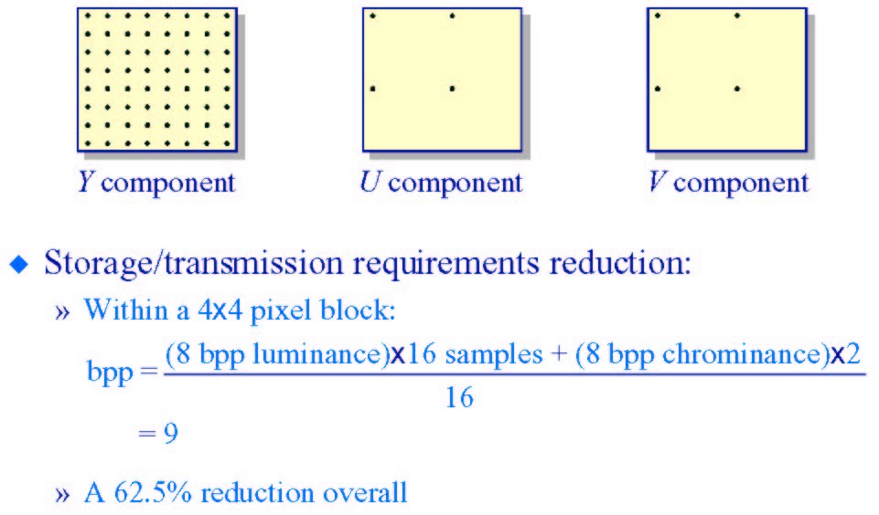
Significant Compression
Notes:
‹#›

Slide 19
Compression Basics
Simple compression
Statistical techniques
Interpolation-based techniques
Transforms
Notes:
‹#›

Slide 20
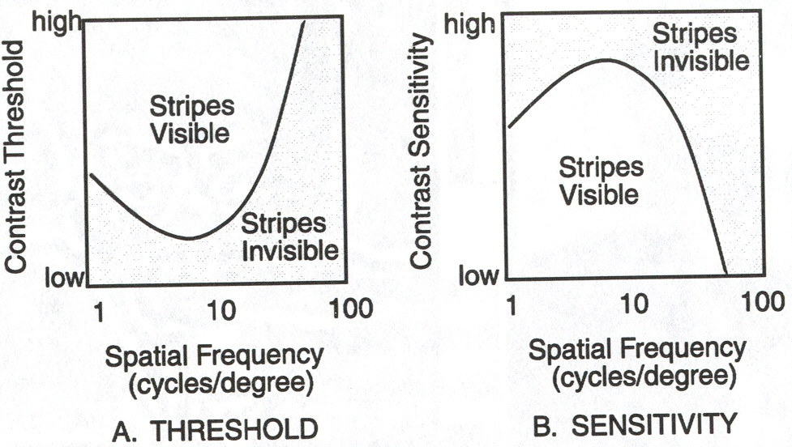
Luminance Contrast Sensitivity
Minimum contrast required to detect a particular frequency
Maximum sensitive at 4-5 cycles per degree
Notes:
‹#›

Slide 21
Testing Contrast Sensitivity
Notes:
‹#›

Slide 22
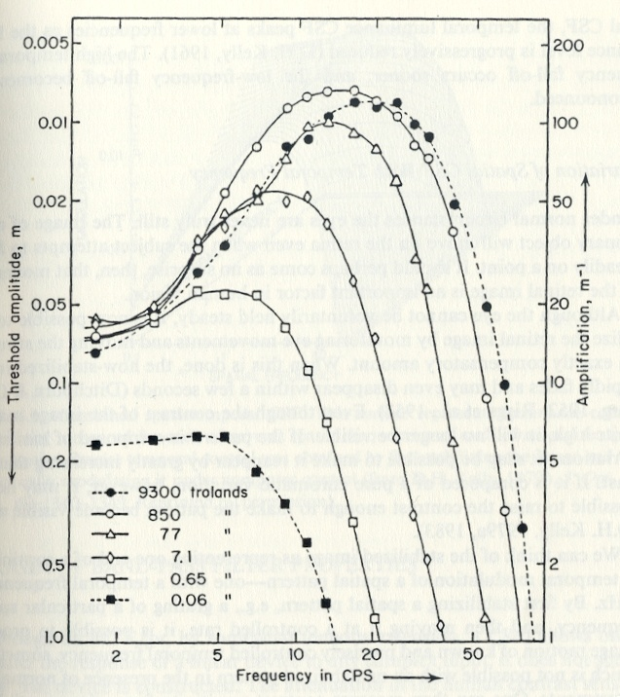
Temporal Contrast Sensitivity
Present image of flat fields temporally varying in intensity like a sine wave
If the flicker is detectable
Cycles per second

Slide 23
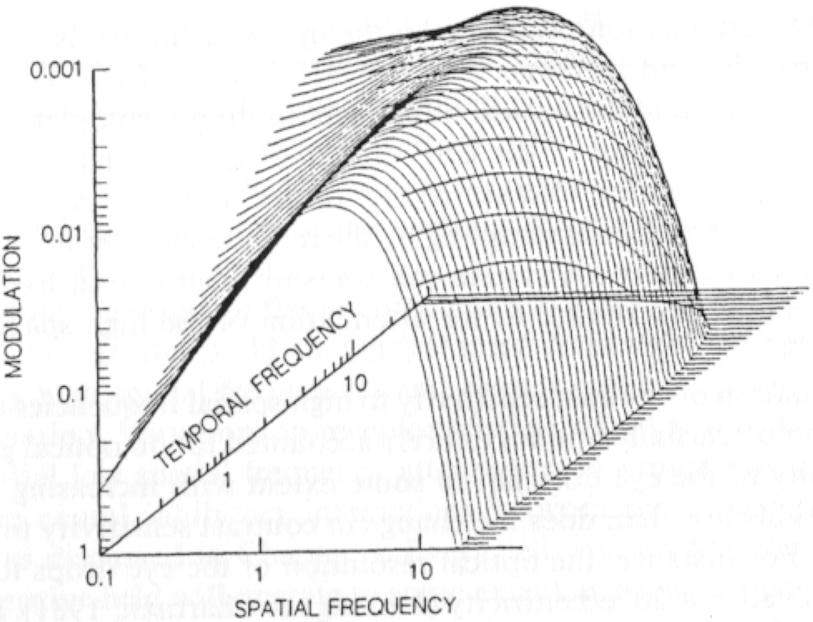
CSF and filters
Both spatial and temporal CSF act as band pass filters
How do they interact?
At higher temporal frequency, acts as low pass filter
Notes:
‹#›

Slide 24
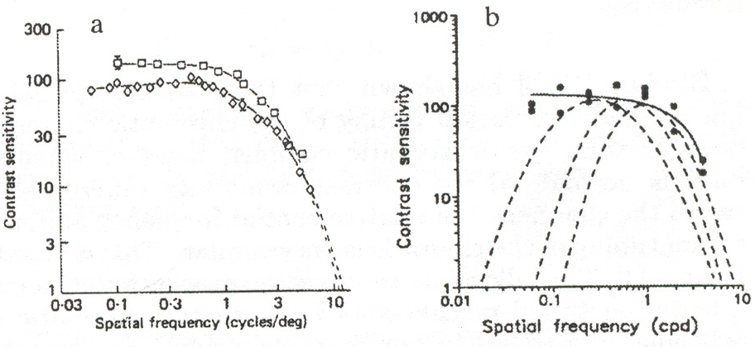
Chrominance Contrast Sensitivity
Gratings
Red-Green (602, 526nm)
Blue-Yellow (470, 577nm)

Slide 25
Compare with luminance CSF
Low pass filter rather than bandpass filter
Sensitivity is lower
More sensitive to luminance change than to chrominance change
High frequency cut-off is 11 cycles per degree rather than 30 cycles per degree
Color acuity is lower than luminance acuity

Slide 26
Important points
We are more sensitive to lower frequencies than to higher frequencies in luminance
We are less sensitive to chrominance than to luminance
We are less sensitive to high temporal frequency
Notes:
‹#›

Slide 30
Notes:
‹#›

Slide 31
Notes:
‹#›

Slide 32
Notes:
‹#›

Slide 33
Humans are not sensitive to high frequencies
Notes:
‹#›

Slide 34
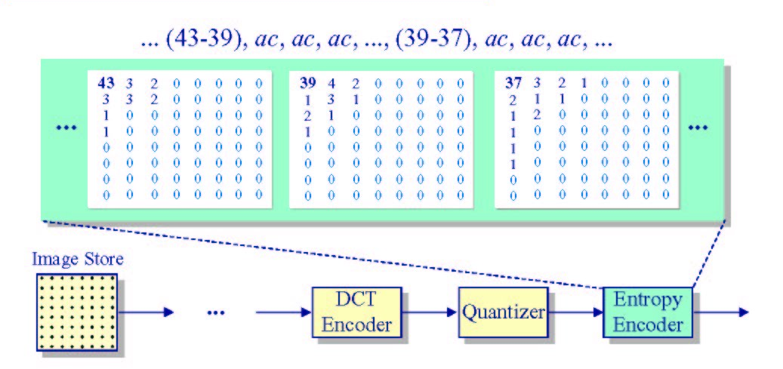
DC Coefficients DPCM
Notes:
‹#›

Slide 35
Notes:
‹#›

Slide 36
Notes:
‹#›

